Slide 1


INSTITUTE : UIE
DEPARTMENT : CSE
Bachelor of Engineering (Computer Science & Engineering)
WEB AND MOBILE SECURITY (Professional Elective-I)
(20CST/IT-333)
TOPIC OF PRESENTATION:
XML based: input injection, external entity injection, and XPath injection
DISCOVER . LEARN . EMPOWER

Slide 2
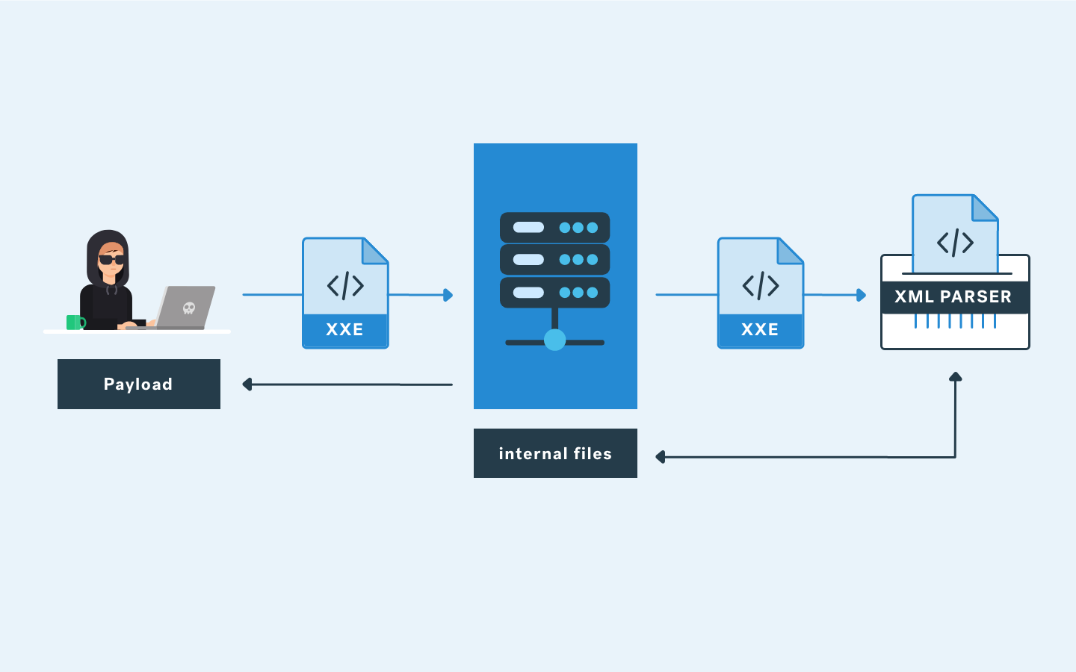
Lecture Objectives
In this lecture, we will discuss:
input injection, external entity injection, and XPath injection

Slide 3
XML injection
XML injection, sometimes called XML code injection, is a category of vulnerabilities where an application doesn’t correctly validate/sanitize user input before using it in an XML document or query. XML, which stands for extensible markup language, is a language format that’s commonly used for structuring storing data. Having XML injection vulnerabilities within your app means that bad guys will have free rein to cause whatever damage they can to your XML documents.
XML injections enable unvalidated user data to construct queries that allow an attacker to read or modify XML documents or execute commands in your XML-enabled database. This enables an attacker to get around your application’s front end to gain access to the juicy stored data they seek by taking advantage of vulnerabilities that exist in input fields (e.g., the user’s name, password, and search input fields).

Slide 4
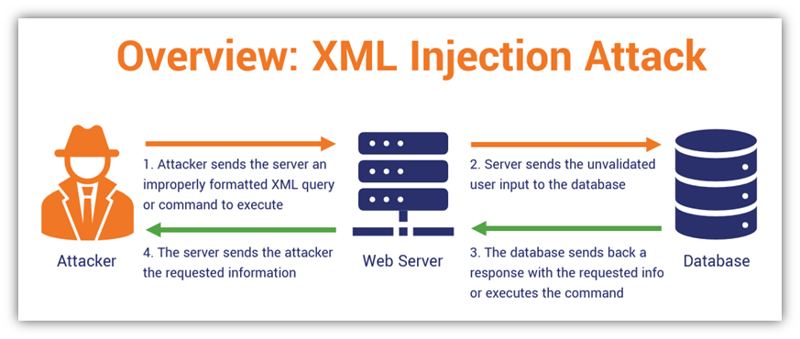

Slide 5
Different Types of XML Injection Attacks
XML entity expansion (XEE) — Also known as XML bombs (aka an XML DoS attack or the “billion laughs attack” we mentioned earlier), this tactic involves an attacker injecting a massive number of recursive or nested references to crash your web app or server.
XML external entity (XXE) — This is where an attacker inserts an external entity reference into their input to either access sensitive XML files that they shouldn’t have access to, or to make malicious queries to external URIs.
XPath injection — This type of attack involves an attacker sending malicious data or commands via an XPath expression to your XML document or database. (XPaths allows you to select specific parts of XML or HTML documents to display on your site or in your app.) By injecting a malicious value into the XPath expression, an attacker can modify or add something to your XML-enabled database or document or do something else (e.g., gain remote access to sensitive data by bypassing authentication).
Blind XPath injection — This is done as a way to carry out an XPath injection when an attacker doesn’t know how a target XML document is structured or if you’re not displaying errors they find useful. This helps an attacker discover how your files are structured and modify the data contained within as desired. This attack method typically consists of XML crawling and Boolean testing to generate true/false responses that inform them whether an attack is successful or failed.
XQuery injection — An attacker uses a malicious XQuery input to execute a malicious command or add unauthorized info to your XML-enabled database or files. XQL injections use XML query language characters to create inputs with invalid syntax to access or modify sensitive information contained within your XML documents or database.

Slide 6
XPath Injection
XPath Injection attacks occur when a web site uses user-supplied information to construct an XPath query for XML data. By sending intentionally malformed information into the web site, an attacker can find out how the XML data is structured, or access data that they may not normally have access to.
They may even be able to elevate their privileges on the web site if the XML data is being used for authentication (such as an XML based user file).
Querying XML is done with XPath, a type of simple descriptive statement that allows the XML query to locate a piece of information. Like SQL, you can specify certain attributes to find, and patterns to match.
When using XML for a web site it is common to accept some form of input on the query string to identify the content to locate and display on the page. This input must be sanitized to verify that it doesn’t mess up the XPath query and return the wrong data.

Slide 7
external entity injection
What is XML external entity injection?
XML external entity injection (also known as XXE) is a web security vulnerability that allows an attacker to interfere with an application's processing of XML data. It often allows an attacker to view files on the application server filesystem, and to interact with any back-end or external systems that the application itself can access.
In some situations, an attacker can escalate an XXE attack to compromise the underlying server or other back-end infrastructure, by leveraging the XXE vulnerability to perform server-side request forgery (SSRF) attacks.

Slide 8
types of XXE attacks
Exploiting XXE to retrieve files, where an external entity is defined containing the contents of a file, and returned in the application's response.
Exploiting XXE to perform SSRF attacks, where an external entity is defined based on a URL to a back-end system.
Exploiting blind XXE exfiltrate data out-of-band, where sensitive data is transmitted from the application server to a system that the attacker controls.
Exploiting blind XXE to retrieve data via error messages, where the attacker can trigger a parsing error message containing sensitive data.

Slide 9
Blind XXE vulnerabilities
Many instances of XXE vulnerabilities are blind. This means that the application does not return the values of any defined external entities in its responses, and so direct retrieval of server-side files is not possible.
Blind XXE vulnerabilities can still be detected and exploited, but more advanced techniques are required. You can sometimes use out-of-band techniques to find vulnerabilities and exploit them to exfiltrate data. And you can sometimes trigger XML parsing errors that lead to disclosure of sensitive data within error messages.

Slide 10
References:
Books:
Web Design With HTML, CSS, JavaScript and jQuery Set, 1st Edition, by Jon Duckett.
Hacking Exposed Web Applications, 3rd edition, Joel Scambray, Vincent Liu, Caleb Sima, Released October 2010, Publisher(s): McGraw-Hill
Video Lectures :
https://www.youtube.com/watch?v=9ZokuRHo-eY
https://getvoip.com/blog/2020/05/06/voip-security/
Reference Links:
https://cheatsheetseries.owasp.org/cheatsheets/Cross_Site_Scripting_Prevention_Cheat_Sheet.html
https://portswigger.net/web-security/cross-site-scripting
https://www.ibm.com/garage/method/practices/code/protect-from-cross-site-scripting/
https://www.thesslstore.com/blog/xml-injection-attacks-what-to-know-about-xpath-xquery-xxe-more/

Slide 11

THANK YOU

